Slide 1
Dendrochronology
How Trees provide Evidence about past Climate

Slide 2
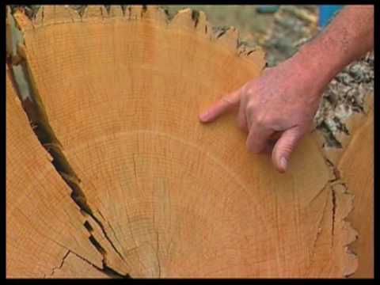
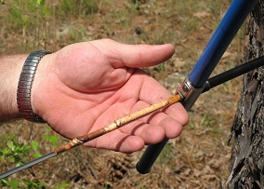
Tree Cookies & Tree Cores

Slide 3
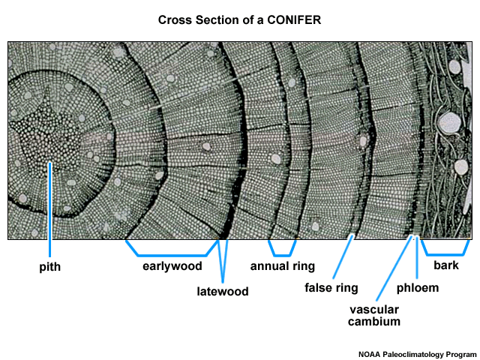
What is Dendrochronology?
Short explanation of Dendrochronology

Slide 4
How do Trees Hold Information about Climate?
Trees grow in both height and width.
The xylem tissue in trees conducts water and dissolved nutrients from the soil throughout the entire tree
Tree Rings are formed in the Xylem layer each growing season
Each Annual Ring has a
  Spring Ring
    Thicker because there is more water present
  Summer Ring
    Thinner and darker in colour because there is less water and the growing xylem cells are smaller
The width of the annual rings is also affect by climatic conditions of that growing year.

Slide 5
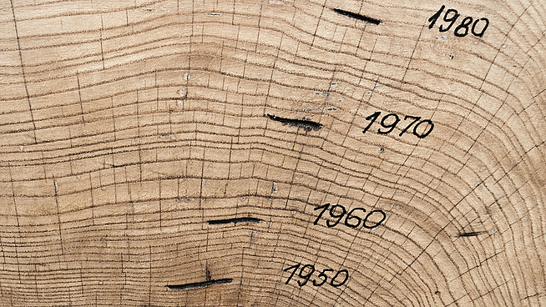
Build a Tree Activity
Build your own Climate Tree

Slide 6
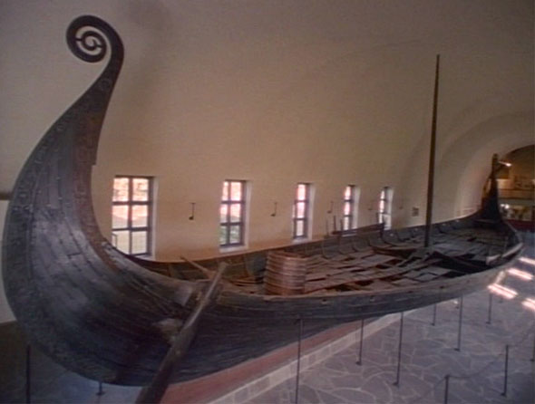
Cool stuff Trees have Told us
The analysis of the oak planks making up one Viking Longship (found in Norway) showed that the wood was from trees cut down near Dublin, Ireland some time between AD 1060-1070.
Discovered in Norway in 1906, the Oseberg ship, the best preserved Viking ship ever found, reveals its Norse shipbuilders' graceful construction style.
Photo credit: © Svergies TV

Slide 7
Activities Today
1. Developing your Dendrochronology Skills
2. Analyzing tree cores to find evidence about a past
climate event

