Slide 1
Nepal Visual Narrative
Ria Guest

Slide 2
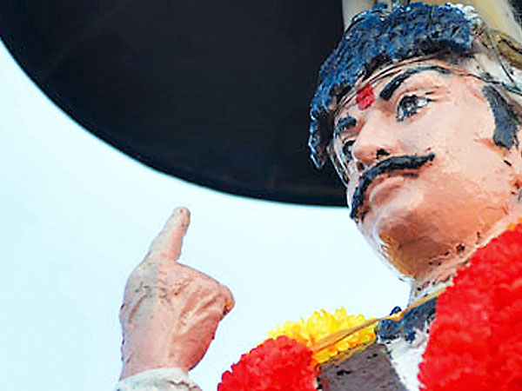
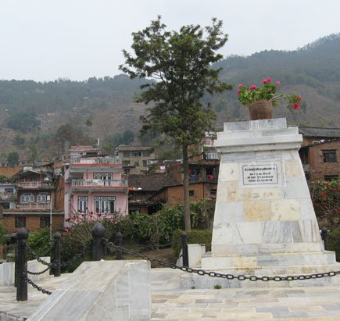
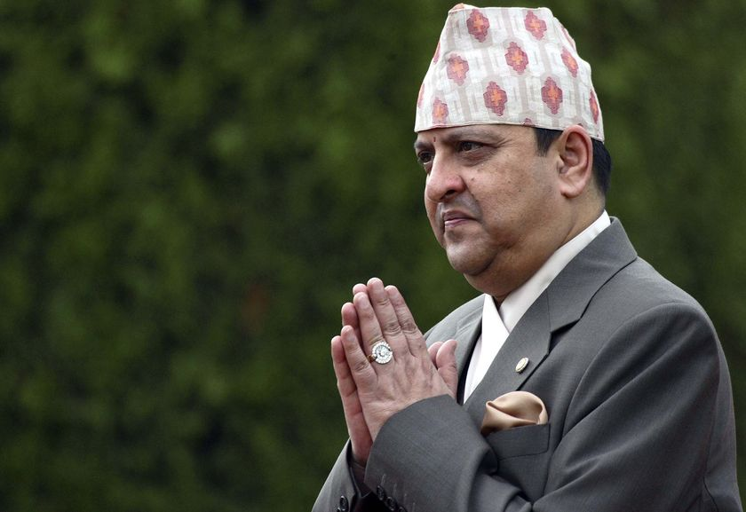
Monarchy
A new statue of PN Shah was made in 2010, but was met with animosity from most Nepalese because of its different appearance than previous statues.
Where the statue of Prithvi Narayan Shah once stood. Pink geraniums replaced him after the Maoists toppled it and dragged its head through the streets during the civil war.
Gyanendra Shah, the last monarch of Nepal.

Slide 3
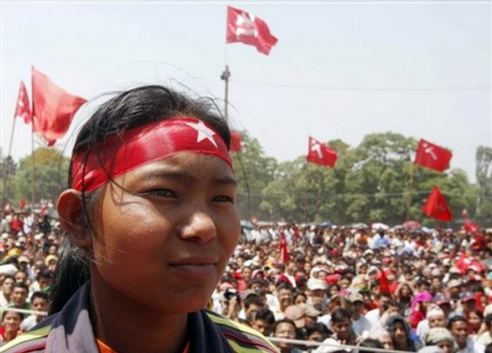
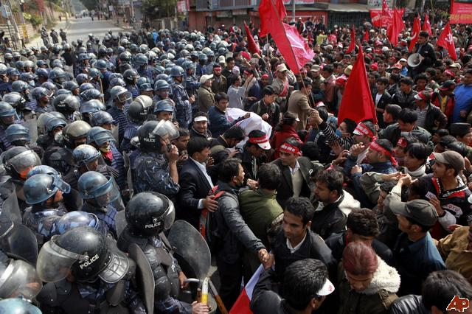
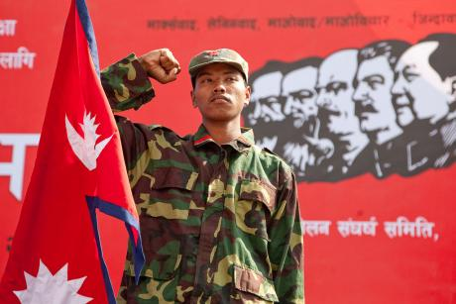
Rise of the Maoists
This photo was taken at the end of the Civil War, but aptly shows the tension between the government and Maoists that frequently erupted.
Maoist representing the Nepalese bourgeoisie.

Slide 4
Maoists and the Government
Maoists want an overhaul of the current government to rebuild it to better the lower and farming classes
They want to end the caste system and landlord class (universalize farmland)
Remove discrimination based on caste, religion, and gender
The Nepalese government spends a lot of time bastardizing the Maoists and making them out through propaganda to be a bigger terrorist threat than they truly are to turn popular urban opinion against the Maoists
The Maoists’ main goal is to upturn the current government and turn it into a grassroot democracy (first removed monarchy, now fighting against internally weak attempt at democracy that only benefits the middle and upper classes)
They also want to bring land back to the tribal people, and enable the poor and landless
HOWEVER- the Maoists are also willing to use armed force to get this done, punish those who have exploited the lower classes, and a total upheaval of all Nepal has been based in for hundreds of years.
The government has its own reasons to fight against the Maoists, including the pursuit of monetary gain by selling minerals on tribal land and trying to suppress a frequently violent movement to keep the rest of the Nepalese safe

Slide 5
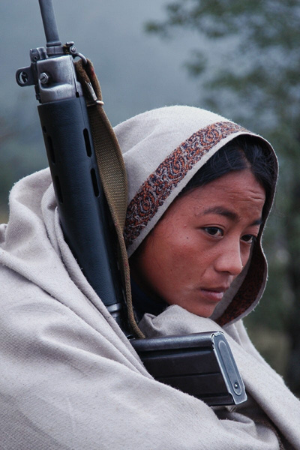
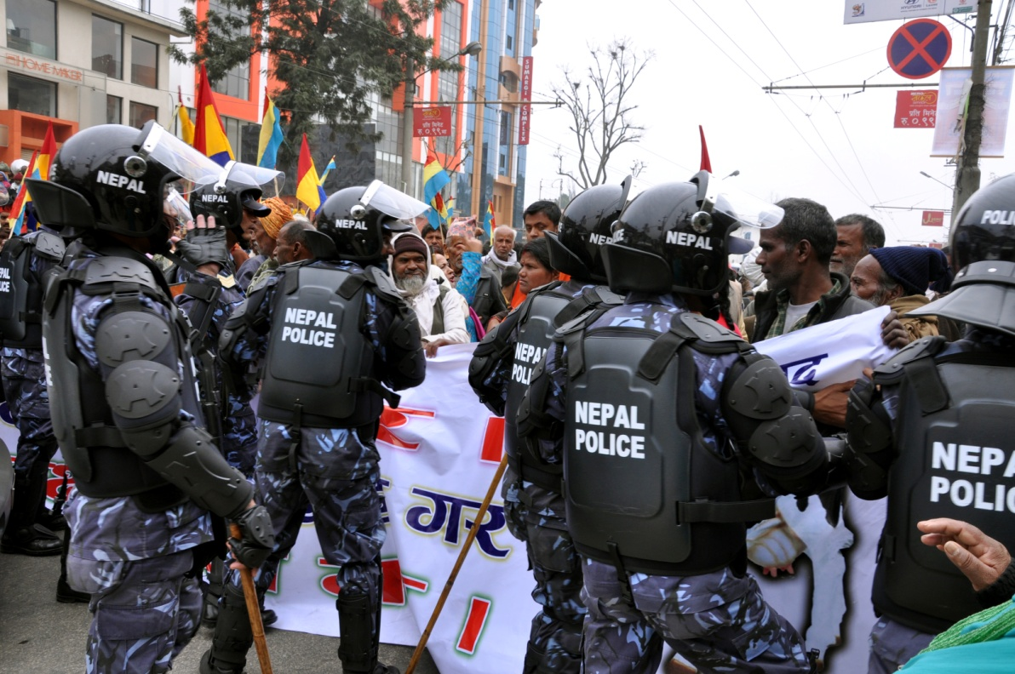
Civil War
The Maoist revolutionaries often met brutal resistance from the monarchy-backed police, and continue to meet government suppression in response to their frequently violent protests.
A young Maoist woman waits for her father.

Slide 6
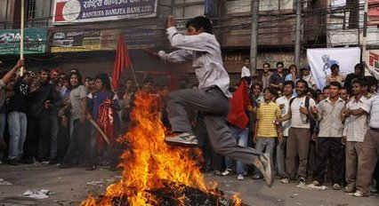
Civil War
Maoists protesting strikes. These protests frequently got violent, groups on either side opening fire on the other.

Slide 7
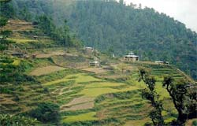
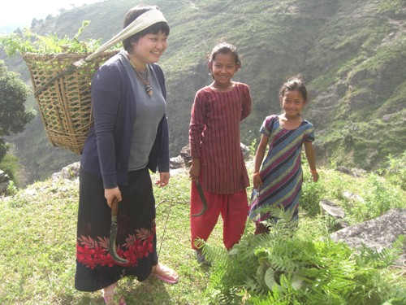
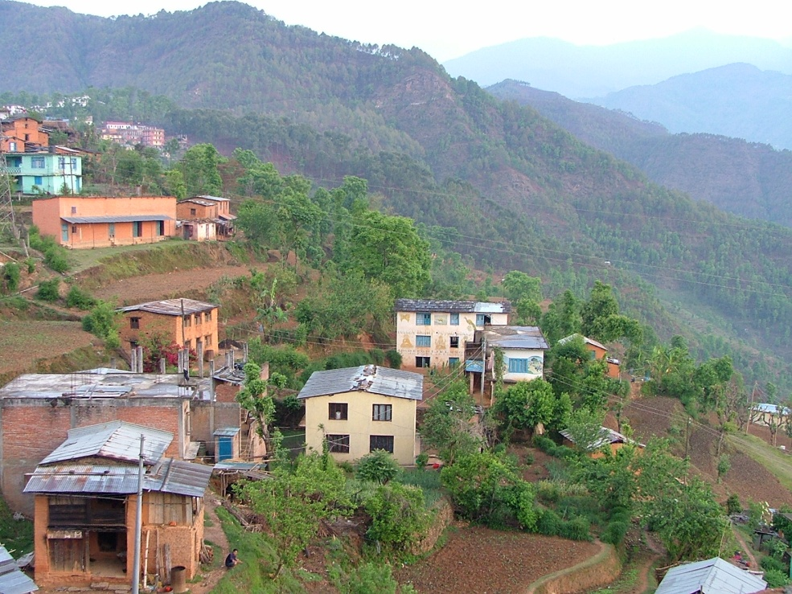
Nepalese Villages
Nepalese villages are usually agrarian and have none or very little technology- few even have reliable water.

Slide 8
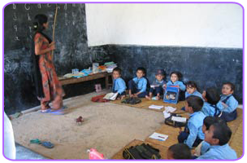
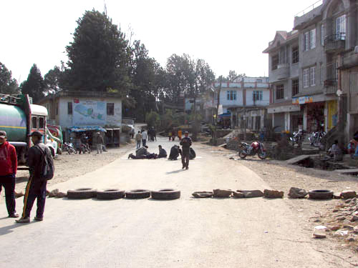
Issues
Bandhs, or roadblocks set up by Maoist extremists, are an issue the Nepalese government is trying hard to crack down on. Many civilians are also against them, because they inconveniences and often become violent.
The lack of nearby or good education systems for village children in Nepal is an issue many grassroots movements and NGOs, such as EFA (Education For All) are working to remedy, by building new schools.

Slide 9
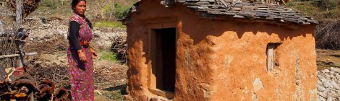
Issues
Women suffer discrimination and violence, often in the home. Chaupadis, where women must go during the menstrual cycle, are one example of discrimination and sexism. Wife beating, violence against women, and dowry-related deaths are all rather common for women as well.

Slide 10
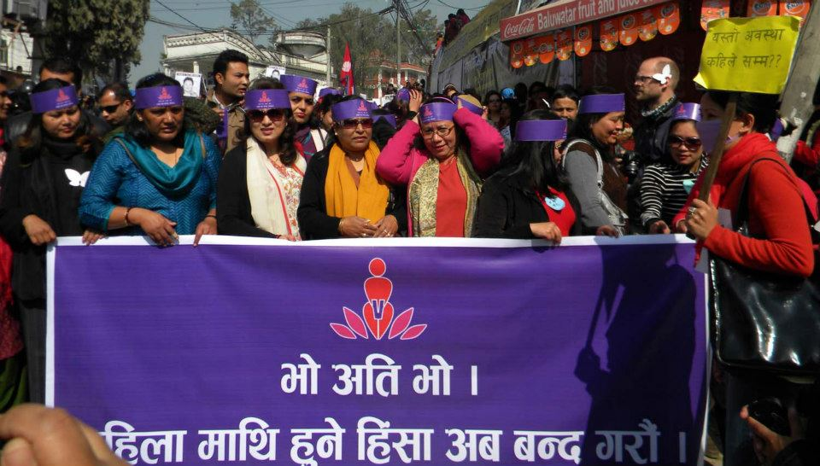
Resolutions?
The Maoists have succeeded in removing the monarchy and gaining some democratic rights for the lower classes
The EFA, a grassroots education movement, had built many schools in Nepal and given teaching jobs, especially to women
The Nepalese government has begun to propose laws to end discrimination and violence against women.
Saathi (peace) is an NGO that has been established in Nepal to support women and inervene with gender-based discrimination and violence; they recently arrested 5 people on the grounds of repeated abuse and have been empowering women throughout Nepal. However, without government and much male support they are having to fight hard.

Slide 11
Sources
Ahdikari. Untitled. 2010. New statue of Prithvi Narayan Shah stirs up hornets’ nest, Nuwakot Durbar, Nepal. Kathmandu Post. Web. 1 Nov. 2013.
Parajuli, Kalpit. 0207 Maoism. 2013. Maoists had enough with Communism, Kathmandu, Nepal. Asia News. Web. 3 Nov. 2013.
Dixit, Kunda. Between Two Stones. N.d. UN: Nepal, Nepal. Chilling in Tampere. Web. 3 Nov. 2013.
Rustad, Harley. Chaupadi. N.d. Nepalese Menstruation Traditions, Nepal. HMR. Web. 4 Nov. 2013.
Unknown. Current Situation. N.d. Current Situation, Nepal. Volunteer for Nepal. Web. 4 Nov. 2013.
Unknown. Gyanendra Shah. N.d. Unknown, Unknown. Keykhabar. Web. 1 Nov. 2013.
Unknown. Nepal Banda. N.d. Anatomy of a Banda, Kailali, Nepal. Nepali Times. Web. 4 Nov. 2013.
Unknown. Nepal Protest_UCPN Maoist Demonstration. 2013. Nepal: Maoists to Gherao Embassy as Part of New Program, Nepal. Revolution in South Asia. Web. 3 Nov. 2013.
Wagle, Dinesh. Where the statue of PN Shah once stood. 2008. In the Peopledom of Gorkha, Gorkha, Nepal. Wagle Street Journal. Web. 1 Nov. 2013.

