Slide 1
Deforestation
The effect it has on our world
By: Emma Slibeck

Slide 2
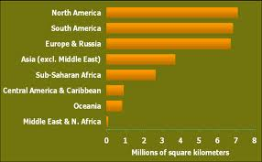
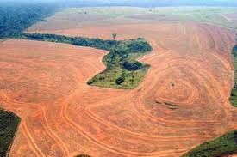
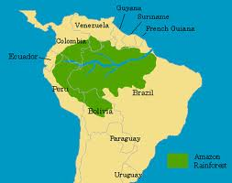
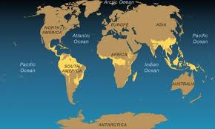
Images of deforestation and where the Amazon is

Slide 3
Facts About the Rainforest
63% of the worlds forests are in Brazil
Deforestation in Brazil has been at its lowest level in 24 years

Slide 4
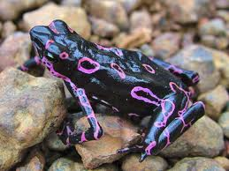
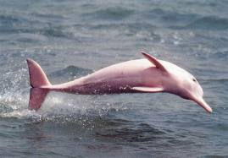
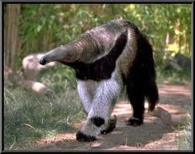
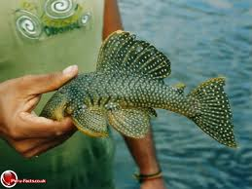
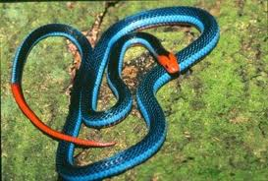
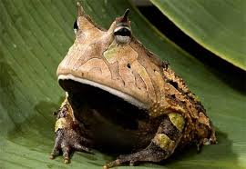
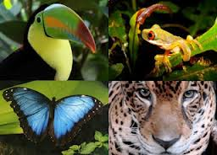
Animals in the Amazon

Slide 5
Some Animals in the Amazon
Anaconda
Howler Monkey
Jaguar
Poison Dart Frog
Sloth
Scarlet Macaw
Spider Monkey
Toucan
Amazon River Dolphin

Slide 6
Some Food that comes from the Rainforest
Brazilian nuts, cayenne pepper, cassava/manioc, cashews, chocolate/cocoa, cinnamon, cloves, coconut, coffee, cola, corn/maize, eggplant, fig, ginger, guava, herbal tea ingredients (hibiscus flowers, orange flowers and peel, lemon grass), jalapeño, lemon, orange, papaya, paprika, peanut, pineapple, rice, winter squash, sweet pepper, sugar, tomato, turmeric, vanilla, Mexican yams, bananas, and many other things

Slide 7
Facts about stuff that comes from the rainforest
One fourth of the medicine you get has something in it from the rainforest
Over half of the millions of known species of plants and animals live in the rainforest.
A flower called the rosy periwinkle helps treat children with Leukemia

Slide 8
How does deforestation affect us?
Many of the things we use, or eat every day are in the forest. If we cut down the forest those animals that live there will be without a home. The things we use from the forest we won’t have anymore. It is important for people to know about how deforestation affects our world, so then we can also know how to preserve our forests. Small things like recycling can change the world. So start helping today. ☺ ☺

Slide 9
Sites
http://environment.nationalgeographic.com/environment/global-warming/deforestation-overview/
http://www.trails.com/list_11191_animals-that-live-amazon-rainforest.html
http://www.huffingtonpost.com/2012/11/27/amazon-deforestation-in-brazil-rainforest_n_2198644.html
http://saveforest.tripod.com/id4.html

