Slide 1

Webinar #2: 29/07/2010
Objectives:
Project updates
Writing Advocacy letters
NGO partnerships

Slide 2
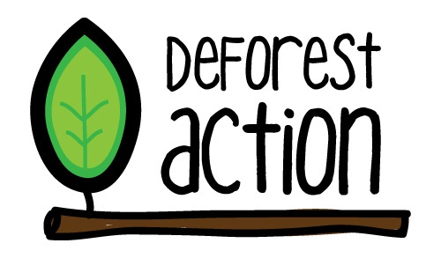
School updates
Spend two minutes updating everyone on your DeforestACTION advocacy projects
Silverton Primary School
Ngee Ann Secondary School
Dallas Primary School
Royal College
Hermit Park State Primary School
Crescent Girls' School

Slide 3
Action and implementation:
Advocacy campaign
Two important objectives for this stage in your Advocacy campaign:
Raising awareness in your school / community/ government
Tree Safe programme

Slide 4

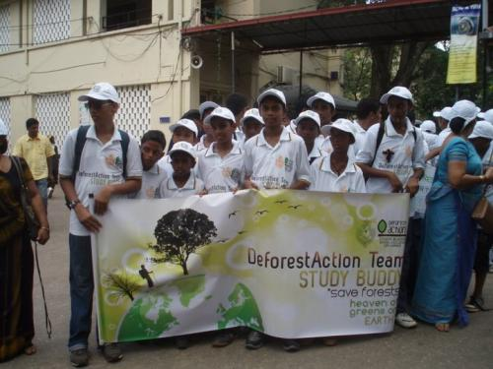
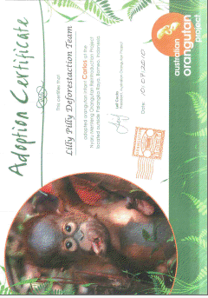
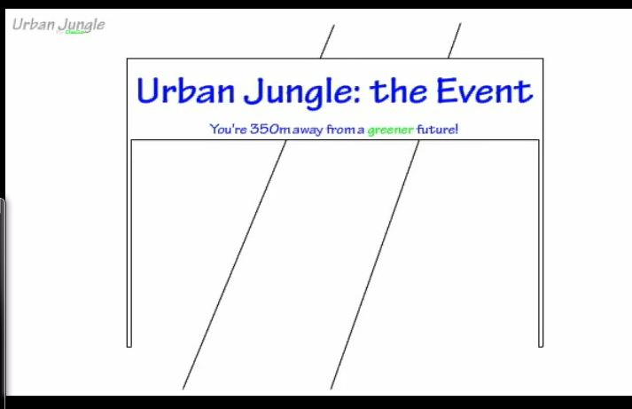
Raising awareness:

Slide 5

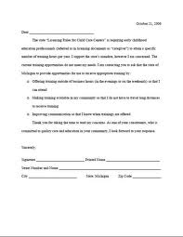
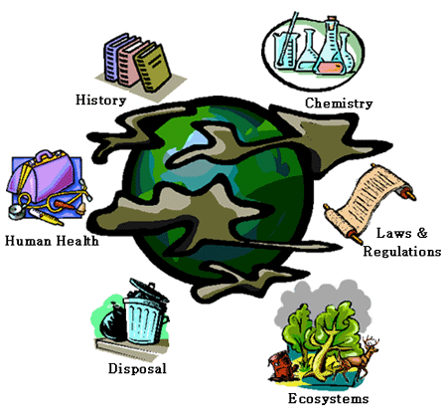
How about raising awareness with local businesses and the GOVERNMENT??

Slide 6
Helping you write these letters:
Log into your DeforestACTION site
Under your classroom click FILES
Under folders click DeforestACTION Advocacy letter
Something to do before the next webinar:
Using the help sheets in the DeforestACTION advocacy file write a letter to key local/ international businesses and the government – NO HARM IN TRYING ☺

Slide 7
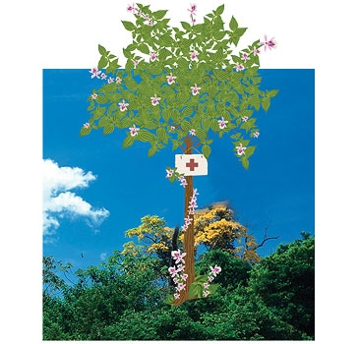
Making the Tree Safe programme work
Why is fundraising important in your DeforestACTION campaigns well...

Slide 8
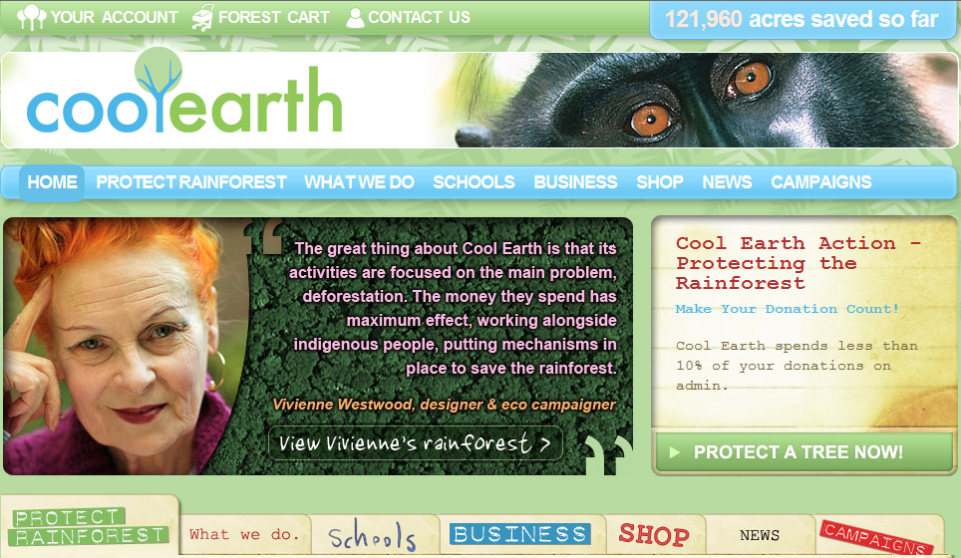
NGO: Option 1

Slide 9
Where will your fundraising money go?
Several possibilities:
Protecting land OR
There is a huge possibility that your fundraising will go towards creating a project where the outcome would be the government hand back land rights to the people. Although this wouldn’t be schools protecting individual acres, it would be an incredible coup, to be responsible for such a landmark achievement and could result in the protection of a large and important habitat for Orang-utans.

Slide 10
Where next... Are you doing this by yourself...
Overall vision:
12 month programme to be launched to the World Wide PIL schools (this will involve thousands of schools joining the programme)
Before the next webinar:
- Each school is to set milestones for themselves – what would you like to achieve as a school from this programme over the next 12 months...
Things to be thinking of...
How to make you campaign bigger and STRONGER
Methods of fundraising – students to write a list of things their school could do and will do to raise funds.
Pairing schools up – encouraging online collaboration (too easy to work in isolation).

