Slide 1
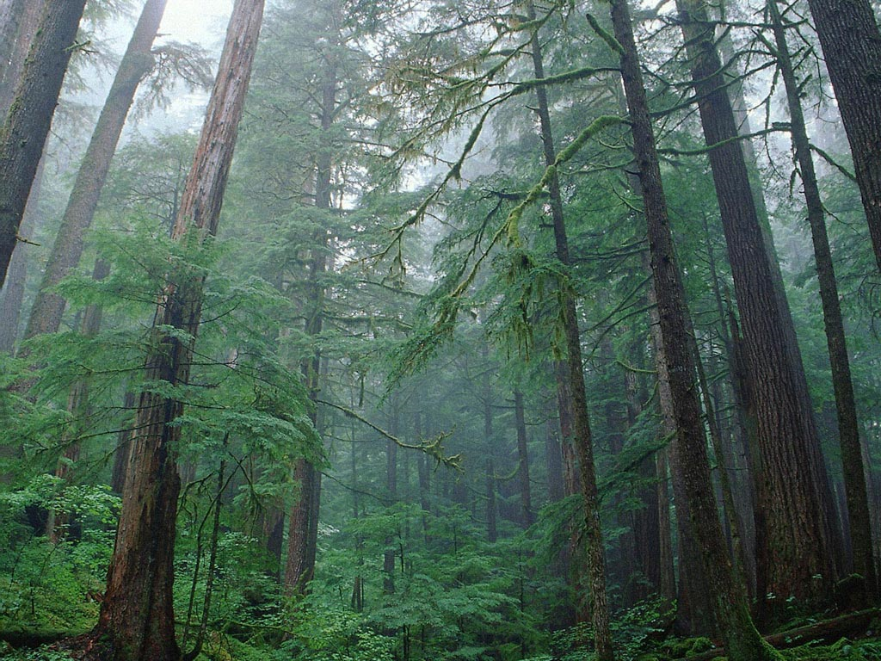
TREE SAFE

Slide 2
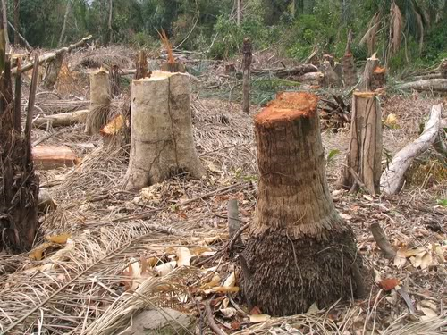
Introduction
According to the United Nations Framework Convention on Climate Change (UNFCCC)
- Subsistence farming is responsible for
48% of deforestation
- Commercial agriculture is responsible for
32% of deforestation
- Logging is responsible for 14% of deforestation
- Fuel wood removals make up 5% of deforestation.

Slide 3

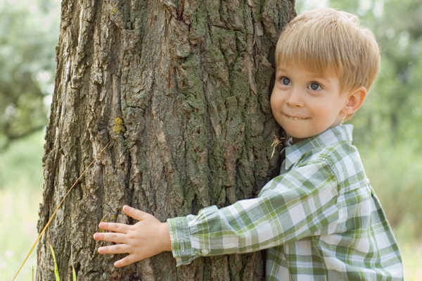
What is the “Tree Safe” idea?
The ‘Tree Safe’ Idea is getting children around the globe to buy a tree which is to be cut down, from anywhere in the world and protect it in order to save the tree from being logged.

Slide 4
How it is done?
Children could either buy a tree individually
OR
Through their school.
More than one tree could be purchased by an individual.
Initially can be bought only for an year, but has the option of buying the same tree again, or a different tree in the next year.

Slide 5
A website will be initiated, in which u could see a satellite image of where your tree is located and also you will be able to view how many trees you have saved.
Schools could join and view how much your school has contributed and draw up a comparison with other schools.
Purchasing of a tree will be also done through the website.
The tree purchased will be randomly assigned.

Slide 6
Sustainability.
It will be extremely successful with all our ideas put together and since this is a novel idea we could work towards grabbing attention and successfully making our attempt extremely sustainable.
This is also a marvelous opportunity for students to witness a greener world in the future.
Hence, contribution is greatly expected. Hence, Sustainability.

Slide 7
How buyers could benefit?
The buyer would receive a certificate with a satellite picture of their tree and also saying they contributed to save our planet.
Schools have a great opportunity to publicize their efforts and contributions in saving trees which will inversely give publicity to schools in a environmentally friendly manner☺
And finally you could say……………………….

Slide 8

I SAVED A TREEEEE!!!!!!☺

Slide 9


