Slide 1

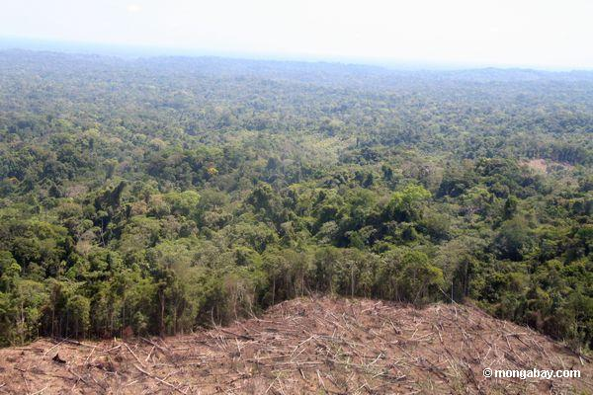
Silverton Primary School’s
DeforestACTION!!

Slide 2

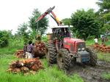


Our Action
Silverton Primary School has chosen to focus on palm oil production as a major cause of deforestation in our Asia Pacific region!
They are cutting down our rainforests in an unsustainable manner to grow palm trees.
Palm oil is present in 50% of the packaged products on our shelves.
Baked products such as bread and biscuits, fried products such as chips, confectionary such as chocolates and cosmetics like shampoo.
Therefore we want to ensure that 25% of global palm oil production is from CSPO (Certified Sustainable Palm Oil)

Slide 3


Students Informed
Become informed about Palm Oil Production and how it causes deforestation by
Researching on the WWF website
Talking to experts
Reading articles and forums
Student discussions online

Slide 4
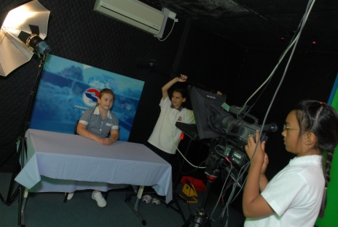
Inform School Community
Inform the school community by
Writing articles in school newsletters, local newspapers, blogs and internet sites
Displays / Flyers in supermarkets/public places
Presentations at own and local schools (students presenting a workshop about palm oil production)
School/local radio stations and TV studios
Writing articles in Education magazines, Shine - for Victorian schools

Slide 5



Identifying Products
At a school level carry out an audit of products that contain Vegetable Oil
  Students can go home and take a look in their cupboards and identify products containing ‘vegetable oil’, possibly Palm Oil.
Write letters to these companies and ask them to state whether they use vegetable oil or is it actually palm oil.
Inform companies about unsustainable palm oil plantations and their role in deforestation of rainforests. If they already do this, congratulate them. If not, encourage these companies to label the palm oil and use CSPO (Certified Sustainable Palm Oil).
Refer them to WWF website.

Slide 6

Spreading the word
Compile and publish a list of CSPO companies. Display lists:
  School websites
  Sustainable school websites
  Taking It global website
  Create our own deforestACTION website
  Publish in school newsletter

Slide 7

Message to Government
Write to government informing him/her about the issue and asking him/her to support the “Food Standards Amendment – truth in labelling palm oil” bill.
If passed this bill will demand that a product list palm oil as an ingredient (CS) or not.

Slide 8


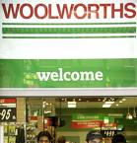
Message to Supermarkets
Write to Supermarket chains/Head office and inform them on this issue to only sell products that use CSPO.

Slide 9


Global Action
Get all other DeforestACTION schools to follow the action in their countries and invite their local schools to take part as well!!

Slide 10

Celebration
Celebrate our success by registering each DeforestACTION school into the International Kids Teaching Kids Coastal Conference in Queensland – Australia, 17th – 19th of October and presenting a workshop about deforestation.

