Slide 1
Urban Jungle
DEFORESTATION ELIMINATED by GAIA
Presented by Team DEGA

Slide 2
Our current situation
Excessive amounts of carbon dioxide in the atmosphere
Leading cause of carbon dioxide emissions is deforestation

Slide 3
Our current situation
80% of the world’s forest have been cleared or compromised by human development
Results in extreme environmental imbalance

Slide 4
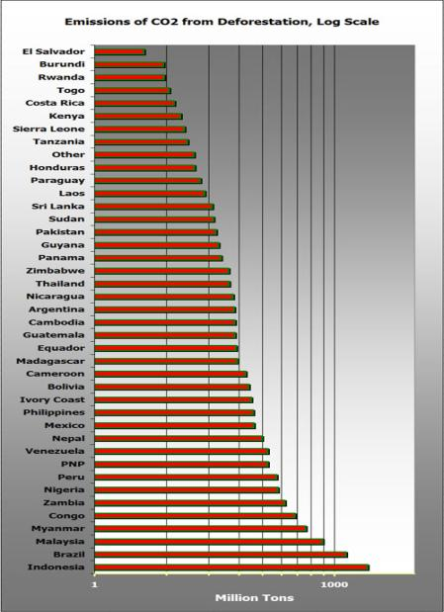

Slide 5
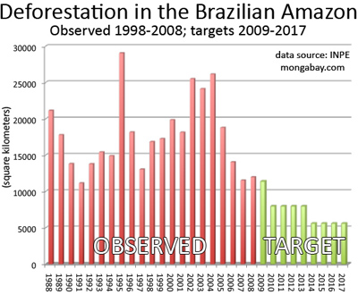

Slide 6
What we can do
The world has two choices:
Continue on the path that will lead to the Earth’s eventual destruction
OR
Make a stand by reducing the amount of carbon dioxide produced each year

Slide 7
WE NEED TO TAKE ACTION!
WE NEED A SOLUTION
!

Slide 8
Criteria For Solution
Economical
No governmental involvement
Reduce amount of carbon dioxide in air
Easy to be carried out by youths/non-governmental organizations

Slide 9
Introducing…
URBAN
JUNGLE
Something achievable, yet incredible

Slide 10
Our Vision
To get every individual to participate in this Urban Jungle project by 2012, thereby reducing carbon dioxide emissions and increasing the amount of carbon dioxide converted to oxygen.

Slide 11
Goals
To reduce the amount of carbon dioxide in the atmosphere due to DEFORESTATION
To encourage a green lifestyle
To educate people on the importance of potting a plant

Slide 12
What we will do
Encourage every family or every household to pot at least a type of plant.
Talks can be held to educate families and companies on the correct way of potting.
Community campaigns can be held to create community gardens

Slide 13
Benefits
Amount of carbon dioxide found in the atmosphere will be reduced
People will become environmentally conscious
People will learn about their responsibility and ways to take care of the planet

Slide 14
Encourage the People
In order to raise awareness and encourage people, we can use the following techniques.
Through Online Media
Through Endorsement
Through Educating the public
Through Incentives

Slide 15
Online Media
Social Networking Pages
Facebook
  Fan pages, groups, etc..
  Urban Jungle’s Group @ http://www.facebook.com/group.php?gid=114630388559340
2. Twitter (update followers)
3. Websites
4. Blogs

Slide 16
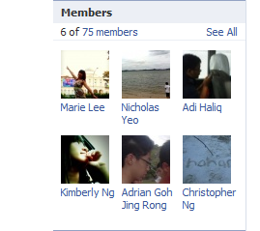
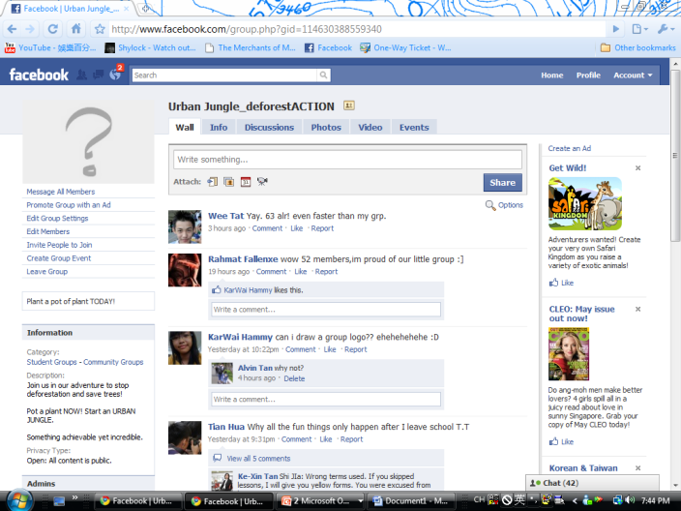
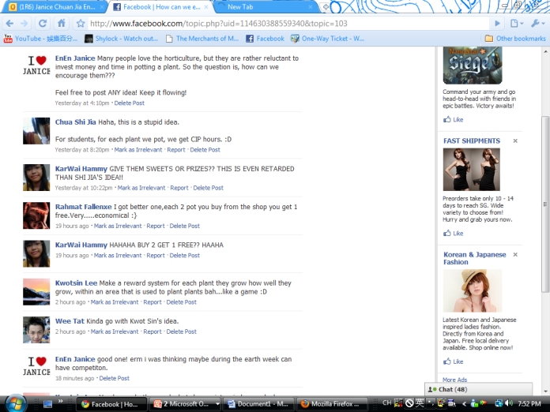
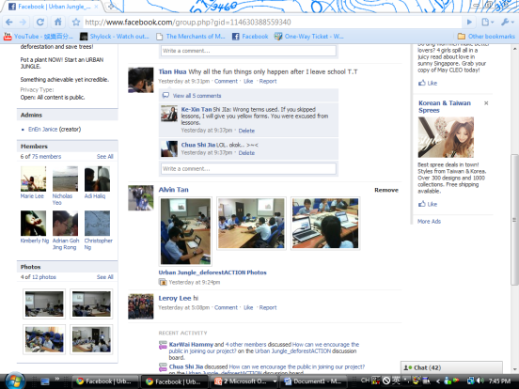
Facebook group

Slide 17

Endorsement
Celebrity Endorsement

Slide 18
Educating The Public
Educating…
  Cultivate a pro-green stance
  through seminars.
  Teaching less developed countries
  Benefits in the long run
  Consequences of not participating

Slide 19
Incentives
Rewards system
  Plants can be exchanged for daily necessities
  eg toilet rolls, instant noodles, etc..

Slide 20
Partnership
Encourage participation through schools worldwide
  eg. get schools to have one plant per class
Encourage participation through events worldwide
Promoting urban jungle through talks

Slide 21
Feedback
“I think this project could repair the marks made by previous generations. All the best!” – Kenny, 3R2, Ngee Ann Secondary School.
“It’s a well-developed, practical, and simple plan. It will however, take a lot of persistence, energy, and commitment to carry it out. I hope our youth have the spirit and energy to prevail. The environment is one of our most important causes.” – Miss Kulyk, Geography teacher of Ngee Ann Secondary School.

Slide 22
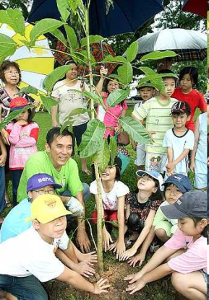
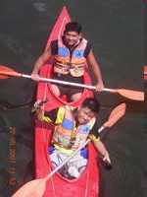
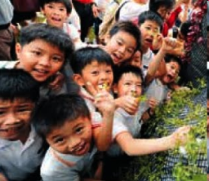
Youth Participation

Slide 23
Thank you for your attention!
Proudly presented to you by Team DEGA,
Ngee Ann Secondary School, Singapore

