Slide 1

Webinar #2: 23/10/2010
Objectives:
Smart Goals
DeforestACTION action plan

Slide 2

Smart Goals
Share your school’s three Smart Goals with everyone!
Dimboola Memorial Secondary College
Waggrakine Primary School
Newton Moore Senior High School
Taroona High School
Kadina Primary School
Varsity College

Slide 3
Post your school’s SMART goals on the discussion thread!

Slide 4
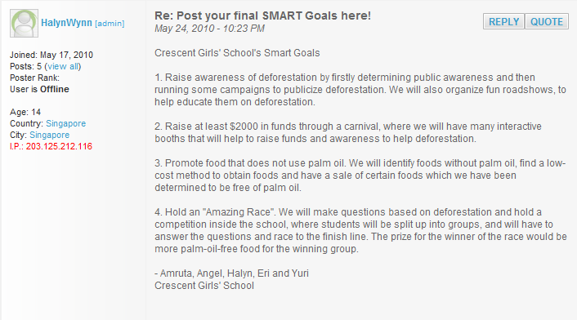
Example:

Slide 5
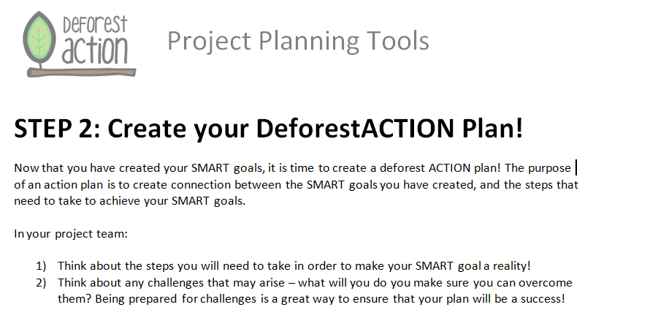

Slide 6
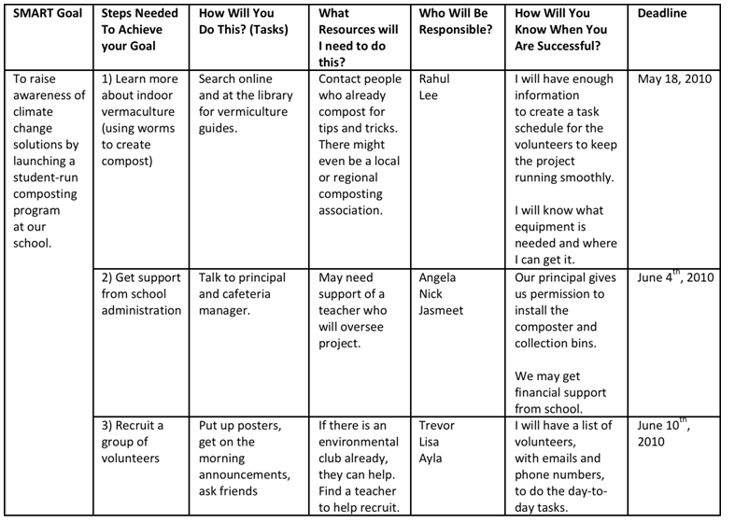

Slide 7
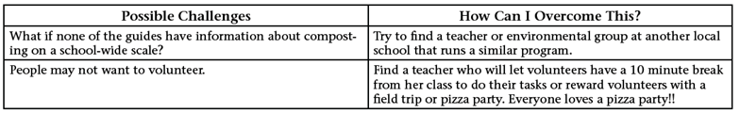

Slide 8
DeforestACTION Plan
Let’s go through the ACTION Plan template!
In your school teams start working on your action plan. All action plans must be uploaded to the files section on the DeforestACTION site by 3rd November!

Slide 9
Build your Community Competition
Special Mentions:
Dimbolla Memorial Secondary College

Slide 10
It’s Important to…
Build a DeforestACTION Community
Upload all work to the site
Upload Action plans to DeforestACTION site by 3rd November 2010
Questions?

