Slide 1

Webinar #1: 15/10/2010
Objectives:
Smart Goals
Importance of Team Work

Slide 2
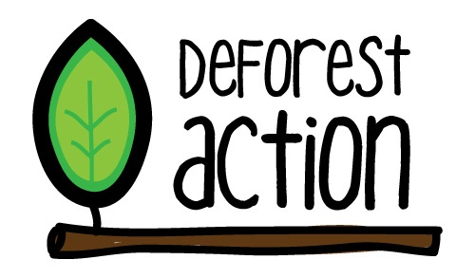
School Introductions
Spend a minute saying HI to everyone!
Dimboola Memorial Secondary College
Waggrakine Primary School
Newton Moore Senior High School
Taroona High School
Kadina Primary School
Varsity College

Slide 3
How it all began...
Teachers and students from across APAC were given the opportunity to present their ideas about what collaborative project they could work on to tackle deforestation.
Students presented their ideas online and were given one week to vote on the two most popular solutions.
The winning solutions were:
Buying back trees in endangered forests to protect them
Raising awareness for how palm oil production (and products that contain palm oil) contribute to global warming, habitat loss, destruction of species and other global problems.
Both solutions were combined to create the DeforestAction global project.

Slide 4
DeforestACTION Project Planning Webinar Schedule
w/b 13th September 2010 - w/b: 8th November 2010
Week | Theme | What | Student Follow-up Activity
Week One: 07/10/2010 | Stage 1 Virtual Conference | All Stage II schools will be invited to the Stage 1 Virtual conference. This will be a DeforestACTION ‘Show and Tell’
Week Two: 15/10/2010 | Introduction/ Creating SMART Goals (Worksheet: Step 1: SMART Project Goals) | Introduce SMART Goals and worksheet Group activity – work on creating sample SMART Goals | Students work in their DeforestACTION teams to create SMART goals Students post their SMART Goals onto DeforestACTION as a blog post
Week Three: 22/10/2010 | Creating Our DeforestACTION Plan (Worksheet: Step 2: Creating your DeforestACTION Plan) | Introduce action plan worksheet Group activity – Things we need to consider in making our action plan | Students fill in action plan template Students upload their file onto DeforestACTION site
Week Four: 05/11/2010 | Action Plan + Presentation (Worksheet: Step 2: Creating your DeforestACTION Plan) | Questions/feedback from students on their action plans so far Information on upcoming virtual conference – Each school to present their action plans during a Virtual Conference (tbc) | Students work on a DeforestACTION presentation to share with rest of DeforestACTION schools.
Week Five: 12/11/2010 | Virtual Conference | This is yet to be confirmed

Slide 5
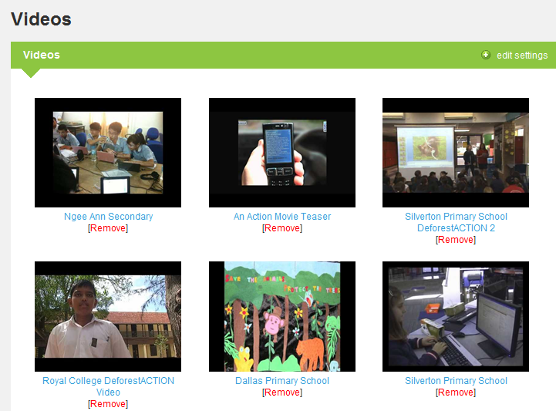
Virtual Conference
http://collab.tiged.org/deforestaction2/videos/

Slide 6
Now it’s over to you...
We would like you to spend the next week coming up with your own DeforestACTION project. The project must be unique to your school and community BUT share the common DeforestACTION objectives..
Raising awareness for how palm oil production (and products that contain palm oil) contribute to global warming, habitat loss, destruction of species and other global problems.
Fundraising (Buying back trees in endangered forests to protect them).

Slide 7
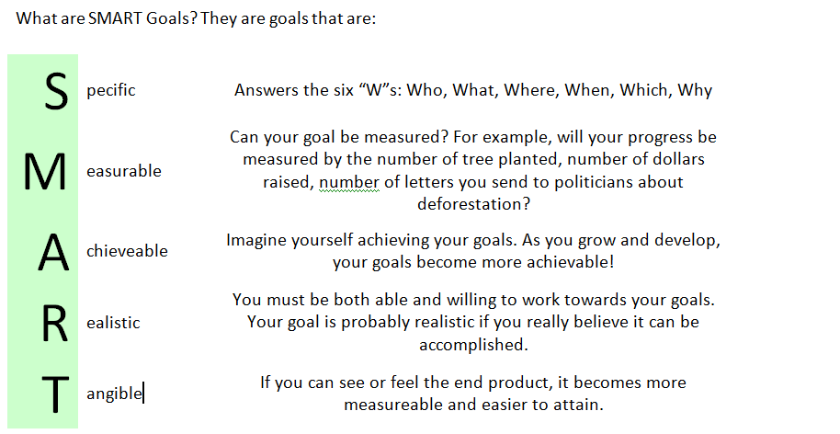
STEP 1: “SMART” Project Goals
The first step in implementing any project is to create “SMART” Project Goals.

Slide 8
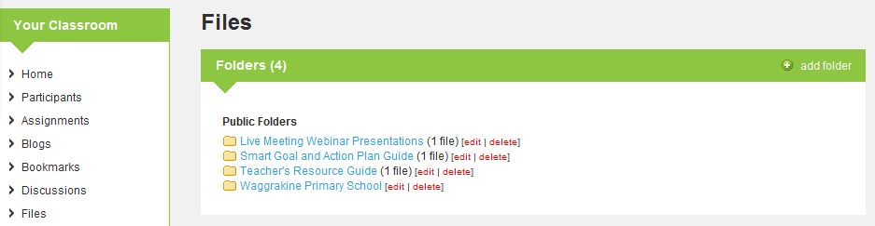
Resources:
http://collab.tiged.org/deforestaction2/files/

Slide 9
By next week...
Students work in their DeforestACTION teams to create SMART goals
Students post their SMART Goals onto DeforestACTION as a blog post (each school should have it’s own blog thread).

Slide 10
QUESTIONS???

