Slide 1

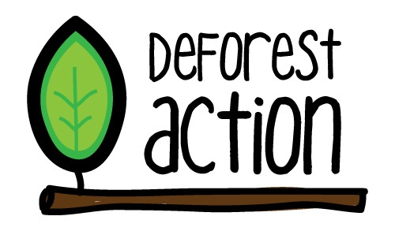

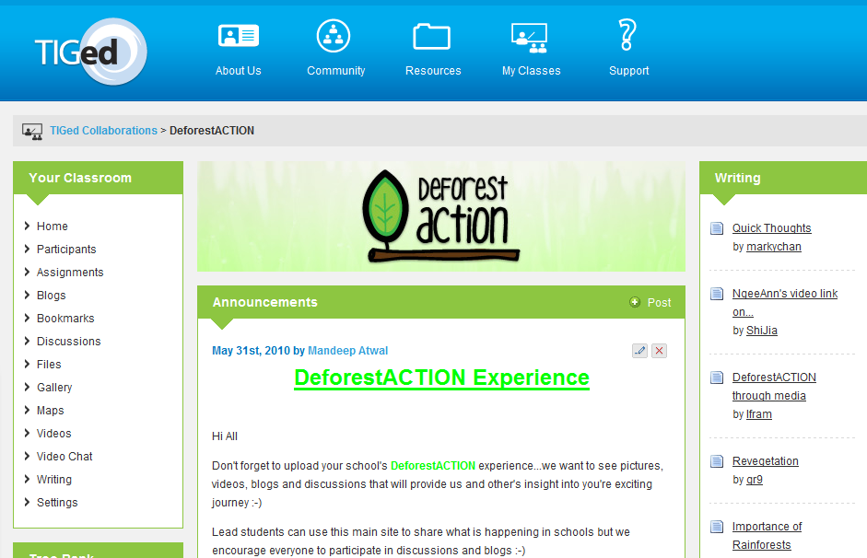
What is DeforestACTION about...
Idea to reality...
The project so far...

Slide 2
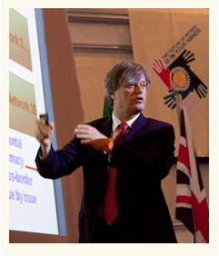
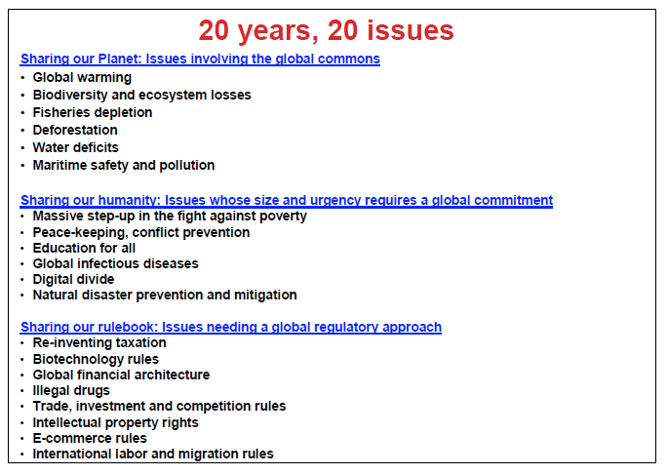


Deforestation
1
20

Slide 3
How it all began...
Teachers and students from across APAC were given the opportunity to present their ideas about what collaborative project they could work on to tackle deforestation.
Students presented their ideas online and were given one week to vote on the two most popular solutions.
The winning solutions were:
Buying back trees in endangered forests to protect them
Raising awareness for how palm oil production (and products that contain palm oil) contribute to global warming, habitat loss, destruction of species and other global problems.
Both solutions were combined to create the DeforestAction global project.
Deforestaction is designed to raise awareness about the destruction of important native forests, and the commercial exploitation of these forests for the production of palm oil. Young people across the planet are seeking support to reclaim at-risk forests and preserve them for future generations, and the future of the planet.

Slide 4
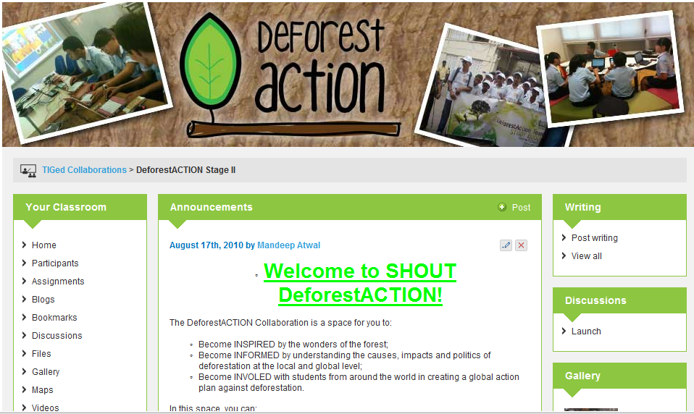
Home Page: http://collab.tiged.org/deforestaction2/

Slide 5
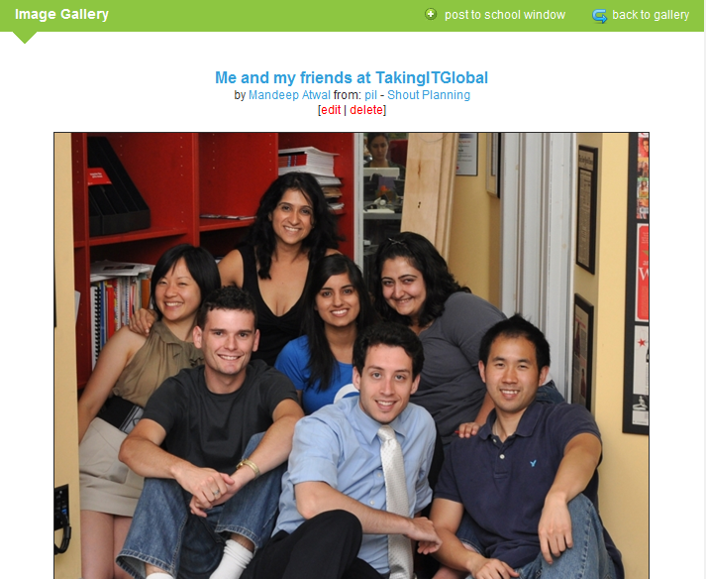
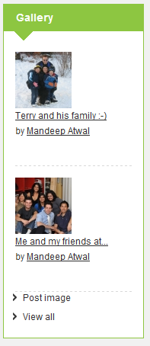
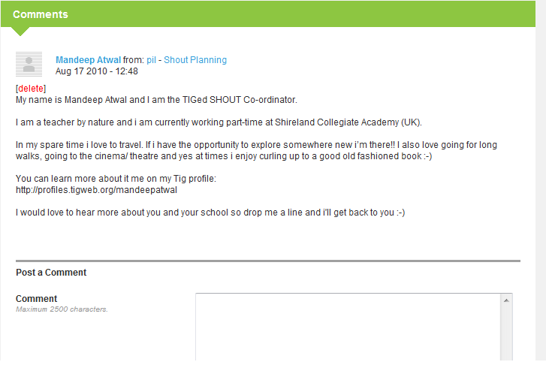
Gallery
Collaboration:@
STEP 1:
Upload a class photo
STEP 2:
Share something about your class with everyone
STEP 3:
Find another school and respond to their comments...

Slide 6

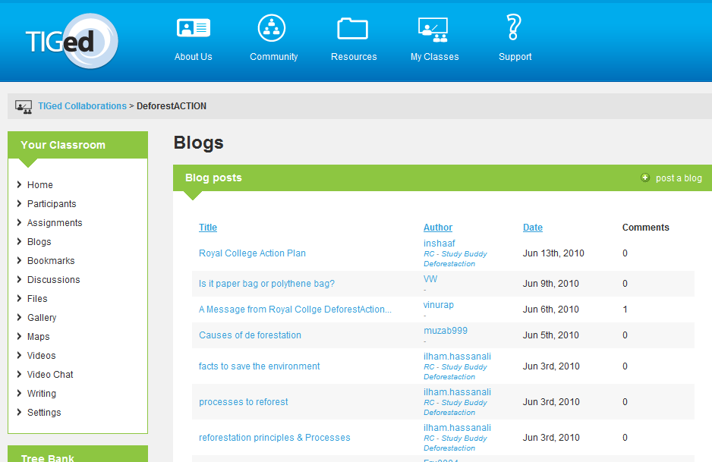
BLOGS = SCHOOL JOURNAL
SCHOOL BLOGS
- Create a school blog. Update the blog once a week. The blog should act as a journal so that anyone, anywhere in the world can follow your schools DeforestACTION story. The blog also has a ‘comments’ tool to allow other schools to comment on your journey!!

Slide 7
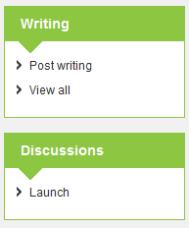
CREATIVE WRITING WALL:
This is a great tool for students to publish their DeforestACTION work for all to see e.g.
Poems
Short stories
Assignments
DISCUSSION WALL:
A place for students to ask questions, share views and opinions on topical issues. The discussion wall is an opportunity for EVERYBODY to get involved ☺

Slide 8
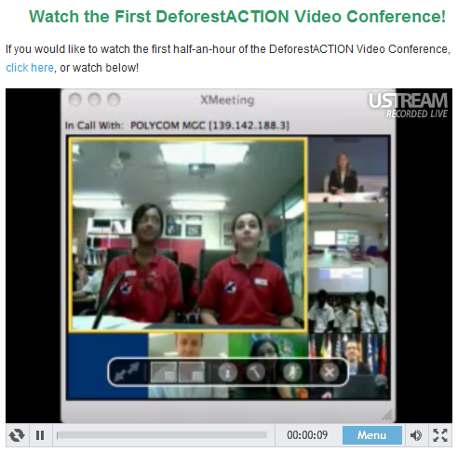
Maps/ Bookmarks/ Files/ Webinars/ Video conferences... LOT’S LOT’S MORE to EXPLORE...

Slide 9
Next steps: 4 mini-tasks
Task 1: TIG profile
Update TIG profiles
(Upload a picture, write a bio... use the following as an example: http://profiles.tigweb.org/mandeepatwal)
Task 2: School Gallery
- Take a class photo. Upload it to the DeforestACTION gallery. Write a little about your class. Find another class from another school and comment on their photo...start collaborating ☺

Slide 10
Task 3: Create a school Blog
Create a school a blog, label your blog clearly with your school’s name. Your first blog post could be about your school?
Task 4: Assignment
- Complete assignment 1 ( separate assignments for Primary and Secondary phases).

Slide 11
What next from us?
We would like to arrange a DeforestACTION orientation with each school.
Could you please email Mandeep Atwal: mandeep@takingitglobal.org with the following information, clearly stating the name of your school:
Teacher contact
Student Lead contact
Technical contact

