Slide 1
Dengue fever
By Dylan, Moana, Peni

Slide 2

What is dengue
Dengue fever or break bone fever is the most common disease in the tropics and is also common elsewhere in the world. It is a disease that is transmitted around by mosquitoes. It is not a lethal disease. However, if left not treated, it can lead to dengue hemorrhage fever, which can be quite fatal.

Slide 3
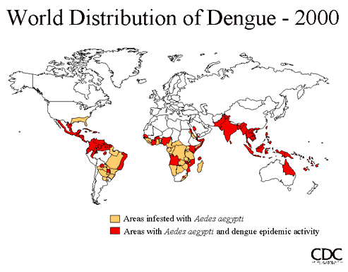
Where it occurs
It occurs widely in the tropics, including the Southern United States, northern Argentina, northern Australia, Bangladesh, Barbados, Bolivia, Belize, Brazil, Cambodia, Colombia, Costa Rica, Cuba, Dominican Republic, French Polynesia, Guadeloupe, El Salvador, Grenada, Guatemala, Guyana, Haiti, Honduras, India, Indonesia, Jamaica, Laos, Malaysia, Melanesia, Mexico, Micronesia, Nicaragua, Pakistan, Panama, Paraguay, The Philippines, Puerto Rico, Samoa, Western Saudi Arabia, Singapore, Sri Lanka, Suriname, Taiwan, Thailand, Trinidad and Tobago, Venezuela and Vietnam, and increasingly in southern China.
The first cases of dengue fever have recently been reported on the island nation of Mauritius in the Indian Ocean. One of the South Asian countries still suffering highly from this problem is Sri Lanka.

Slide 4
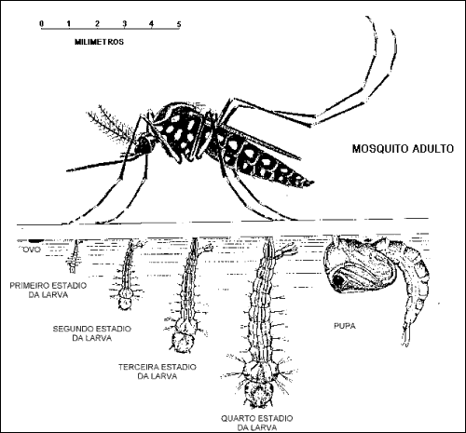
In Fiji
Dengue epidemics had occurred periodically in Fiji since 1885, 1930, 1944, 1971. The
more serious form of the disease, dengue haemorrhagic fever (DHF), first appeared in the
country in 1975 with subsequent outbreaks in 1979-1980 and 1989-90.
In the last epidemic (1989-90) more than 3,600 confirmed cases were reported with 30
reported death due to DHF.
Dengue in Fiji is a disease that is quite serious in Fiji and if were not careful could get even worse.

Slide 5
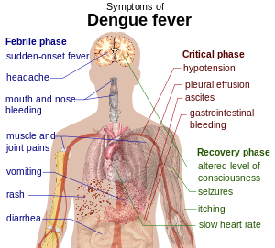
symptoms
The symptoms are headaches, fever, exhaustion, severe joints and muscle pains, swollen glands, and rashes. If you have these symptoms you could have dengue fever.

Slide 6


treatment
Treatment for dengue fever does not include the usage of drugs. Similar to treating the flu, you must:
Drink a lot of fluids, mainly water or electrolyte heavy fluids (Powerade, Gatorade etc)
Resting, this is key so that your body diverts most of its energy to the immune system, so that it helps to make you better.

Slide 7

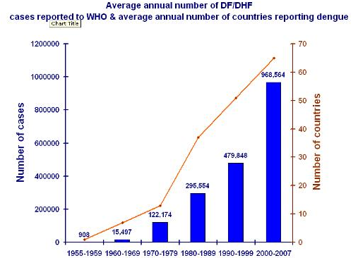

Increases globally
During the 19th century, dengue was considered a sporadic disease that caused epidemics at long intervals, a reflection of the slow pace of transport and limited travel at that time. Today, dengue ranks as the most important mosquito-borne viral disease in the world. In the last 50 years, incidence has increased 30-fold. An estimated 2.5 billion people live in over 100 endemic countries and areas where dengue viruses can be transmitted.

Slide 8
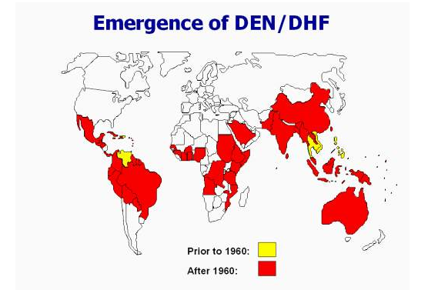
decreases
It is slowly decreasing around parts of the world and is showing good signs for a medicine to help those affected.
Health authorities of Lapu-Lapu City in the Philippines reported a decrease of cases in the first half of the year compared to last year.
Dr. Rodolfo Berame, city health officer, said they recorded 83 dengue cases from January to May this year with one death.
This, he said, is a decrease from last year’s 125 cases.

Slide 9
References
http://www.cdc.gov/dengue/symptoms/index.html
http://www.phac-aspc.gc.ca/tmp-pmv/thn-csv/dengue-eng.php
http://www.nathnac.org/pro/factsheets/dengue.htm
http://naosite.lb.nagasaki-u.ac.jp/dspace/bitstream/10069/4692/1/tm36_04_13_t.pdf
http://newsinfo.inquirer.net/216337/lapu-reports-decrease-in-dengue-cases
http://www.ncbi.nlm.nih.gov/pmc/articles/PMC88892/
http://www.who.int/csr/disease/dengue/impact/en/
http://en.wikipedia.org/wiki/Dengue_fever

