Slide 1
Bilharzia
By Nicolas, Daniel, Gareth

Slide 2
What is it?
A DISEASE!!!!!
A WORM!!!!!
A CURSE!!!!!

Slide 3
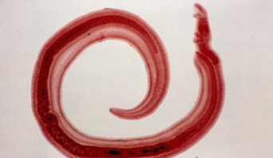

Slide 4
Why, Why, WHY?
WHY ME!?!?!
WHY YOU !?!?!
WHY EVERYONE !?!?!

Slide 5
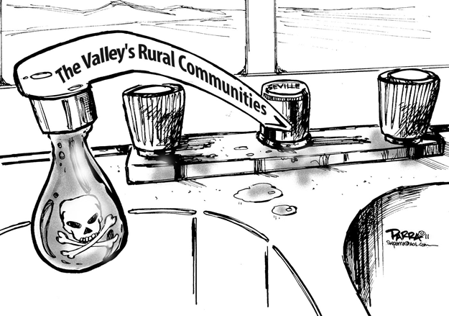

Slide 6
It’s Discovery
WHO DID THIS!?!?!
WHERE WAS THIS!?!?!
WHY WAS THIS!?!?!

Slide 7
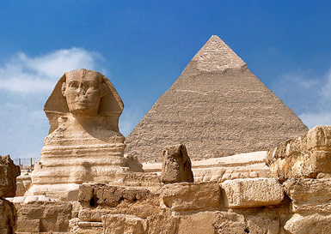

Slide 8
Where is it?
HERE!!!!!
THERE!!!!!
EVERYWHERE!!!!!

Slide 9
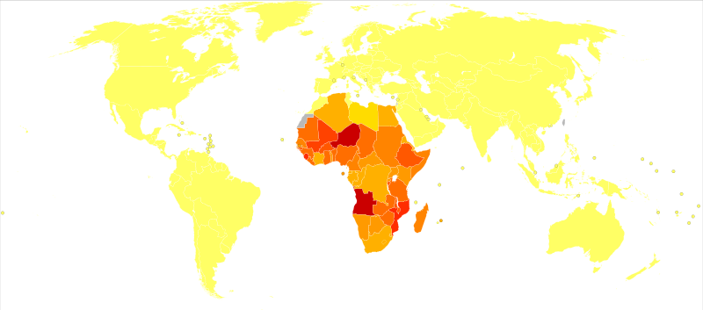

Slide 10
How do you know?
OMG!!!!!
I’M TOTALLY!!!!!
CLUELESS!!!!!

Slide 11
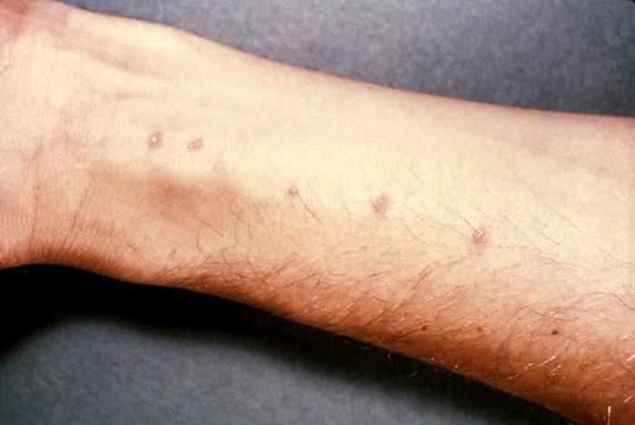

Slide 12
How do I get rid of it?
OMG!!!!!
IT’S LIKE TOTALLY!!!!!
EVERYWHERE!!!!!

Slide 13
