Slide 1
AIDS/HIV
Chloe Hotaling
AIDS is the most advanced stage of HIV infection. The definition of AIDS includes all HIV-infected people who have fewer than 200 CD4+ cells per microliter of blood.

Slide 2
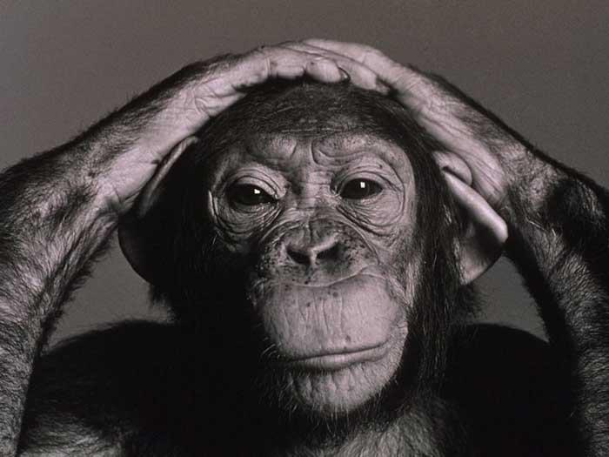
Origin
Chimpanzees & Hunter-Gatherers
West Africa, then spread to other parts of the world
32,000 years ago, wild chimps were infected simultaneously with two different Simian Immunodeficiency Viruses(SIV) which had "viral sex" to form a third virus that could be passed on to other chimps and, which was capable of infecting humans and causing AIDS.
First recognized cases of AIDS occurred in the USA in the early 1980s
Notes:
Scientists identified a type of chimpanzee in West Africa as the source of HIV infection in humans.
The chimpanzee version of the immunodeficiency virus (called simian immunodeficiency virus or SIV) most likely was transmitted to humans and mutated into HIV when humans hunted these chimpanzees for meat and came into contact with their infected blood.
Over decades, the virus slowly spread across Africa and later into other parts of the world.
The most commonly accepted theory is that of the 'hunter'. In this scenario, SIVcpz was transferred to humans as a result of chimps being killed and eaten or their blood getting into cuts or wounds on the hunter. Normally the hunter's body would have fought off SIV, but on a few occasions it adapted itself within its new human host and became HIV-1. The fact that there were several different early strains of HIV, each with a slightly different genetic make-up (the most common of which was HIV-1 group M), would support this theory: every time it passed from a chimpanzee to a man, it would have developed in a slightly different way within his body, and thus produced a slightly different strain. It likely that one single syringe would have been used to inject multiple patients without any sterilisation in between. This would rapidly have transferred any viral particles (within a hunter's blood for example) from one person to another, creating huge potential for the virus to mutate and replicate in each new individual it entered, even if the SIV within the original person infected had not yet converted to HIV.
In areas such as French Equatorial Africa and the Belgian Congo, colonial rule was particularly harsh and many Africans were forced into labour camps where sanitation was poor, food was scarce and physical demands were extreme. many of the labourers would have been inoculated with unsterile needles against diseases such as smallpox (to keep them alive and working), and that many of the camps actively employed prostitutes to keep the workers happy, creating numerous possibilities for onward transmission.

Slide 3
Origin
  Startly mostly with gay men
  HIV = Human Immunodeficiency Virus --> Lentivirus: "slow virus" which attacks the immune system
  In the late 19th and early 20th century, areas such as French Equatorial Africa and the Belgian Congo, colonial rule was particularly harsh and many Africans were inoculated with unsterile needles and then were forced into labor camps where many prostitutes were employed to keep the workers happy, creating numerous possibilities for infection.

Slide 4

Symptoms
Some people have a flu-like illness within several days to weeks after exposure to the virus.
Following initial infection, there may be no symptoms. This state may last from a few months to more than 10 year
The progression of disease varies widely among individuals.
Vision loss
Weight loss and extreme fatigue
Cough and shortness of breath
Seizures and lack of coordination
Difficult or painful swallowing
Severe and persistent diarrhea
Coma
Fever
During this period, the virus continues to actively multiply, infect, and kill the cells of the immune system.
The immune system allows us to fight against the bacteria, viruses, and other infectious causes.
Nausea, abdominal cramps, and vomiting
Severe headaches with neck stiffness
Mental symptoms: confusion and memory issues
Notes:
After the diagnosis of AIDS is made, the average survival time has been estimated to be 2-3 years.

Slide 5

Treatment
There are more than 20 approved antiretroviral drugs but not all are licensed or available in every country
Antiretrovirals, ARVs, anti-HIV or anti-AIDS drugs:
- Main type of treatment for HIV or AIDS.
- Not a cure, but can stop illness onset for many years.
- Drugs have to be taken every day for the rest of a person’s life.
- Keeps the amount of HIV in the body at a low level; stops weakening of the immune system
- Allows recovery from any damage that HIV might have caused already.
Common complementary therapies:
Physical therapies: yoga, massage, acupuncture
Relaxation techniques: meditation, visualization
Herbal medicine
Without treatment, almost everyone with HIV will get AIDS.
Notes:
Healthy people use these kinds of therapies to try to make their immune systems stronger and to make themselves feel better in general. People who have diseases or illnesses, such as HIV, use these therapies for the same reasons. They also can use these therapies to help deal with symptoms of the disease or side effects from the medicines that treat the disease.

Slide 6
Statistics
http://aids.gov/hiv-aids-basics/hiv-aids-101/statistics/
http://aids.gov/hiv-aids-basics/hiv-aids-101/global-statistics/index.html

Slide 7

Prevention
Always wear protection when having any kind of sex!

Slide 8
Sources
http://www.cdc.gov/hiv/topics/basic/#spread
http://www.avert.org/treatment.htm
http://www.webmd.com/hiv-aids/guide/hiv-aids-treatment

