Slide 1
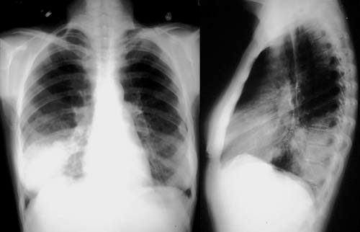
Pneumonia
By Adrian Kelly

Slide 2
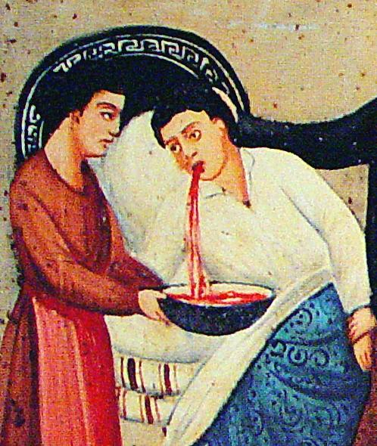
What is Pneumonia?
Lung Infection
Bacteria, viruses or fungi
Leading cause of child deaths
Most deadly viral infection

Slide 3
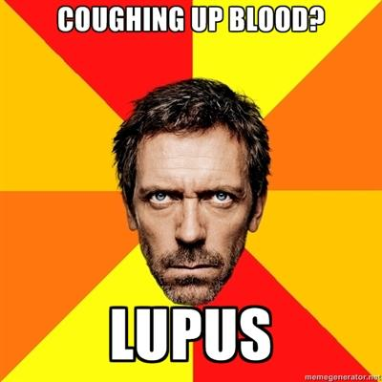
Signs and Symptoms
Fever
Nausea
Weakness
Chest pain
Wheezing cough
Trouble breathing
Excess mucus
Coughing blood
Vomiting
Hypothermia
Convulsions

Slide 4
Symptom Causes
Inflammation and irritation
Abcesses
Fluid
Infection

Slide 5
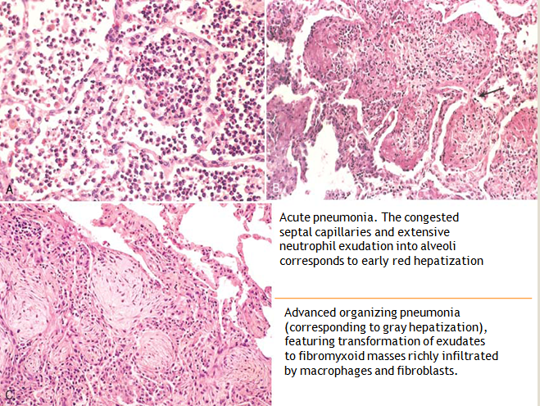
Types
Bacterial (Strep, Pneumococcus, Pertussis)
Viral (Flu, RSV, Chickenpox, Measles)
Fungal (Pneumocystis)
Parasitic
Lobar
Bronchial
Interstitial

Slide 6
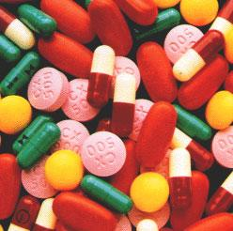
Treatment
Rest and water
Identification
Antibiotics and Antivirals
Anti-inflamatories
Mucolytics
Antipyretics

Slide 7
Causes
Weak immune system:
Children
Elderly
Smokers and asthma
Diabetes
Other diseases
Hospitals (HCAP, HAP, VAP)
Indoor air pollution
Alergens and chemicals

Slide 8
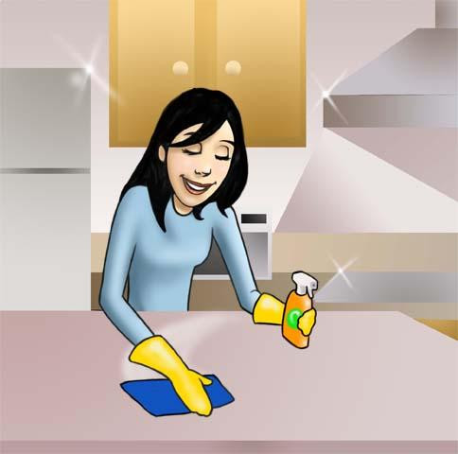
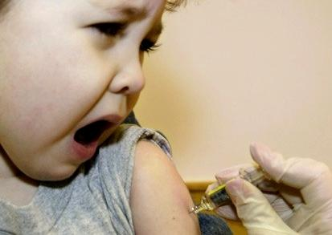
Prevention
Vaccines
Cleaning
Keep healthy
World Pneumonia Day:
November 12

Slide 9
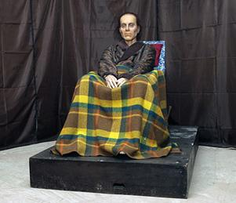
Famous People
Freddie Mercury
Leo Tolstoy
Beethoven
Fred Astaire
James Buchanan
Groucho Marx
John Muir

Slide 10
Sources
cdc.gov/Features/Pneumonia/
cdc.gov/nchs/fastats/pneumonia.htm
cdc.gov/mmwr/preview/mmwrhtml/mm6133a4.htm?s_cid=mm6133a4_w
lung.org/lung-disease/pneumonia/
who.int/mediacentre/factsheets/fs331/en/
who.int/topics/pneumococcal_infections/en/
webmd.com/lung/viral-pneumonia
medicinembbs.blogspot.com/2011/01/types-of-pneumonia.html
healthoncare.com/pneumonia-inflammation-of-the-lungs.html
umm.edu/patiented/articles/how_serious_pneumonia_000064_4.htm

